Slide 1

ASTROSAGE ANALYSIS
Presented by Neelam Rajput

Slide 2
ASTROSAGE PLATFORM OVERVIEW
Platform Type: Online marketplace for astrology services via mobile app and web portal.
Scale:
70M+ app downloads globally.
11M+ monthly active users.
700,000+ registered astrologers/gurus.
Core Services:
Live consultations (Chat/Audio/Video).
Free Horoscopes & Kundli (Birth Charts).
E-commerce (Gemstones, remedies).

Slide 3
PROBLEM STATEMENT
AstroSage has received a 1 crore investment and aims to optimize its call center operations. The goal is to determine how to allocate this investment to maximize operational efficiency, customer satisfaction, and profitability. The analysis will consider historical call data, performance metrics, and market trends to make informed decisions.

Slide 4
OVERVIEW OF DATA
Dataset :-28027 consultation records of 34 days .
Attributes :- 35 columns (call details, status, chat time, refund status , etc.)
Time Duration :- 1st December 2023 to 3rd Jan 2024.
Scope of Analysis:-
Addition of new users and revenue earned.
Performance of Gurus and workload distribution.
Feedback analysis.
Preference of consultation type by user and call status.

Slide 5
METHODOLOGY
Analytical approach:
Data Cleaning : by removing duplicates, filling blank values, inserting the required columns.
Analysis : Identifying the major KPIs and Creating pivot tables to summarize data.
Visualization : With the help of chats and graphs.
Insights :for better utilization of investment.
Tools used:
Excel( data cleaning, pivot table ,charts, formatting)
Functions (COUNT,AVERAGE,SUM,CORREL)
presenting everything in dashboard with slicers .

Slide 6
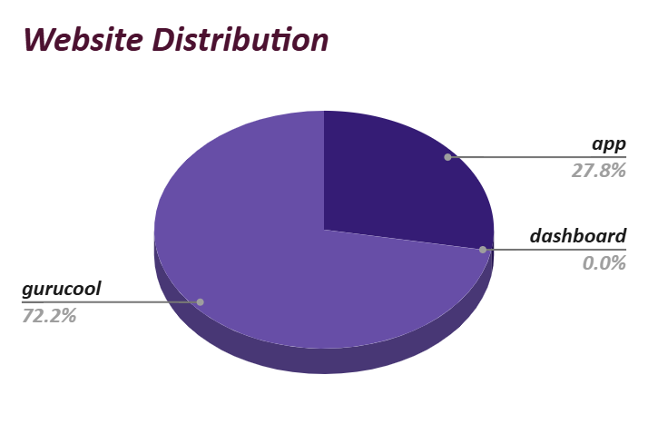
USER PLATFORM PREFERENCE
Most preferred choice is Gurucool .
Using the mobile app is second most preferred choice.
Via dashboard the engagement is minimal.

Slide 7
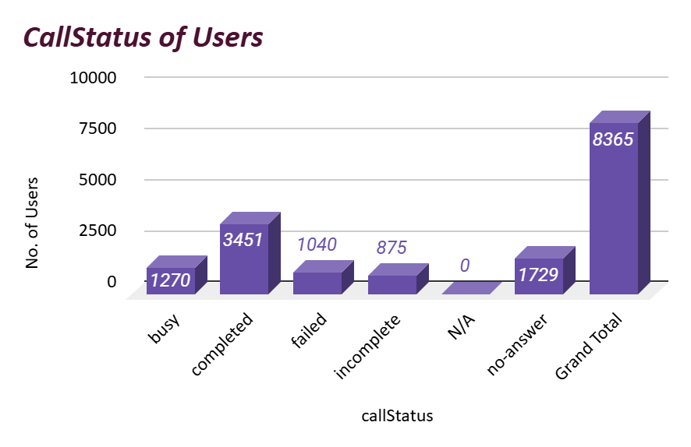
CALL HANDLING EFFICIENCY
Only 41% of calls are successfully completed .
35% of calls are failed or not answered .
Smart routing can improve success rate.

Slide 8
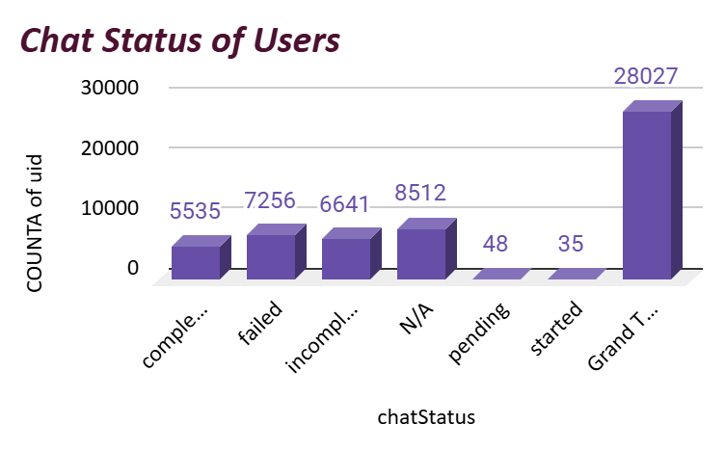
CHAT STATUS DISTRIBUTION
High chat completion rate reflects operational efficiency.
Using AI-driven automation for incomplete chats.

Slide 9
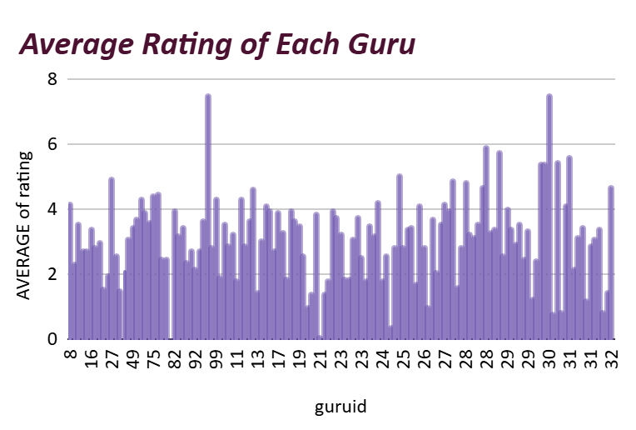
RATING WISE GURU DISTRIBUTION
High performers have specialized expertise.
Focus on training of potential performers.
Get insights from top gurus for training.

Slide 10
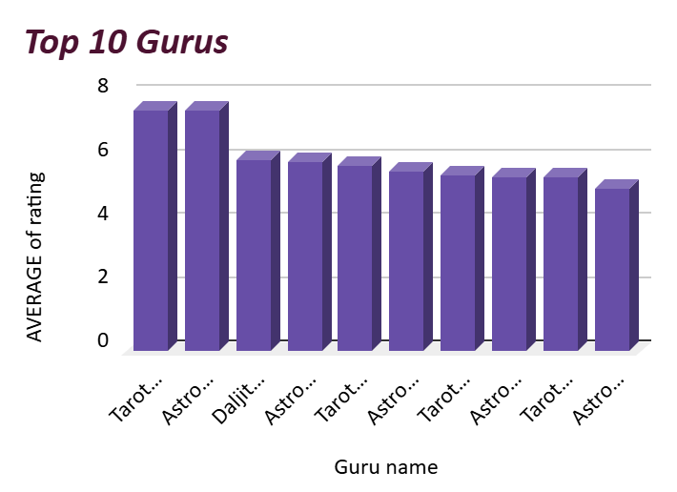
10 HIGHLY RATED GURUS
A small number of gurus got high average rating.
Get insights from them to train other gurus.
Tarot mystical and Astro Puja Rai are top performers.

Slide 11
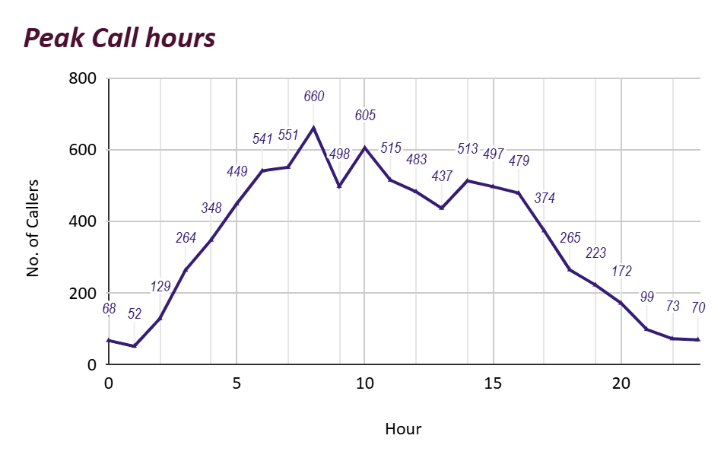
PEAK TIMINGS OF RUSH
Customer activity is high from 6 A.M. to 5 P.M.
Highlighting opportunities for workforce optimization and demand-based scheduling.

Slide 12
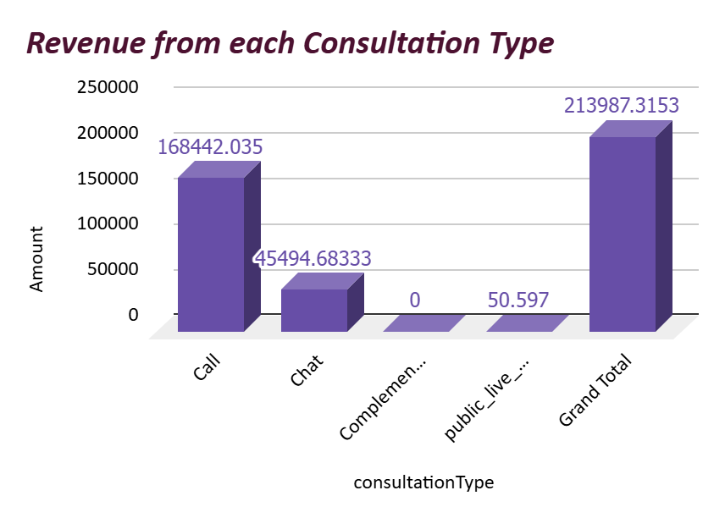
REVENUE SOURCE
Calls generate the highest earnings .
Chats offers cost-efficient scalability.
Revenue concentrated among top gurus and peak demand hours.

Slide 13
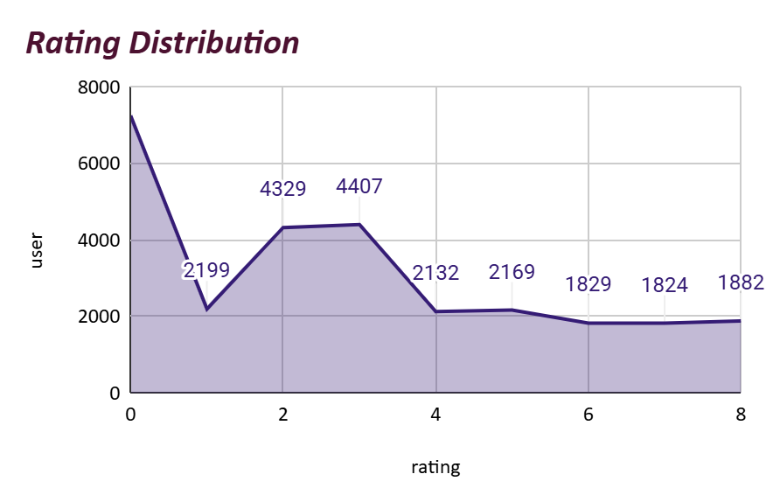
PERFORMANCE OF GURUS
A significant number of agents received zero ratings, .
Immediate training is required for unskilled staff members.
Get insights from top performers.

Slide 14
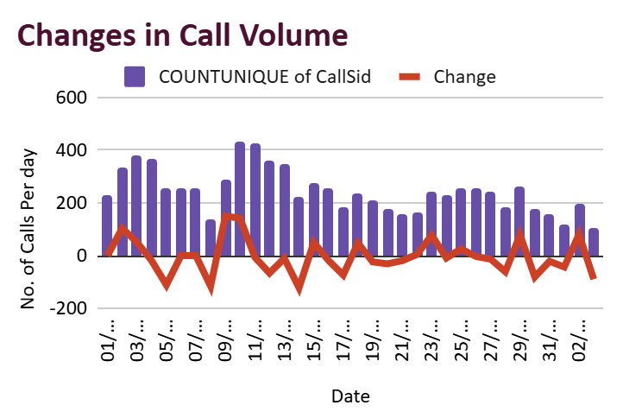
CHANGES IN CALL VOLUME
Call demand fluctuates across days.
There is need to adapt flexible staffing.
Weekdays are mostly busy.

Slide 15
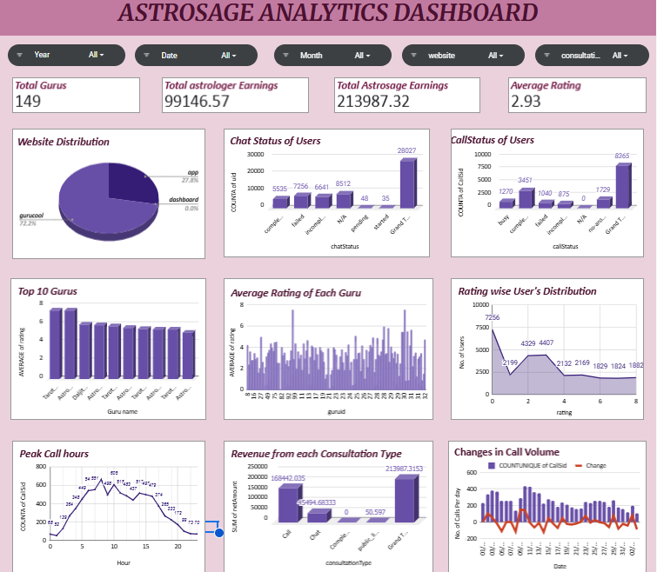

Slide 16
CONCLUSIONS
Key Gap Identified: High volume of repeat calls (4879 total, from 275 repeat callers), indicating efficiency issues.
Performance : High number of sessions were rated 3 or below representing the disappointment among users .Even some gurus got rated well too proving their skills .
Opportunity: Targeted investment in technology, training, and incentives will improve overall performance.

Slide 17
RECOMMENDATIONS
Invest in Technology Upgrades: Improve call routing, IVR, and CRM systems to raise completion and First Call Resolution (FCR) rates.
Optimize Workforce Utilization: Rebalance workloads, schedule efficiently, and share best practices from top performers.
Enhance Training & Incentives: Focus on empathy and problem-solving skills to boost CSAT and agent retention.
Implement Performance Monitoring: Use live dashboards to keep a constant eye on agent performance metrics.

Slide 18
Thank you…
By Neelam Rajput
Dated 04-01-2026

